Slide 1
Static Local Variables & Default Arguments
ELEC1006: ENGINEERING COMPUTING

Slide 2

Static Local Variables
Local variables only exist while the function is executing. When the function terminates, the contents of local variables are lost.
static local variables retain their contents between function calls.
static local variables are defined and initialized only the first time the function is executed. 0 is the default initialization value.
PAGE 2

Slide 3
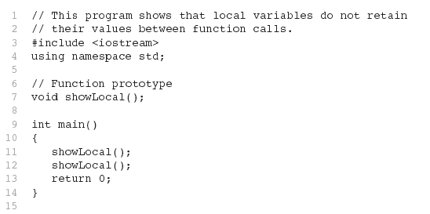
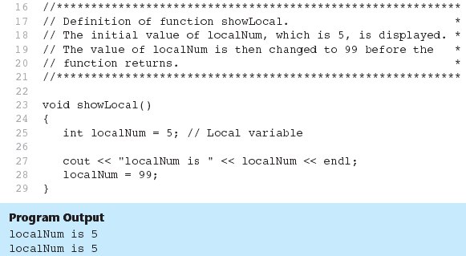
Example 1: Local Variables
In this program, each time showLocal is called, the localNum variable is re-created and initialized with the value 5.
PAGE 3

Slide 4
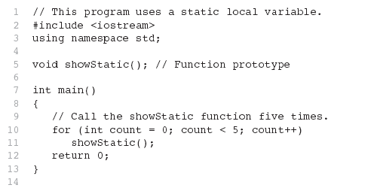
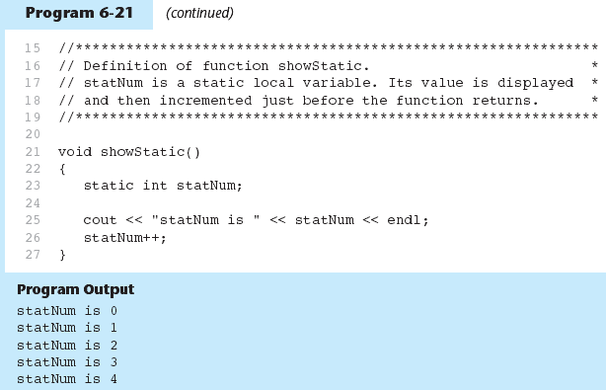
Example 2: Static Local Variables
statNum is automatically initialized to 0. Notice that it retains its value between function calls.
PAGE 4

Slide 5
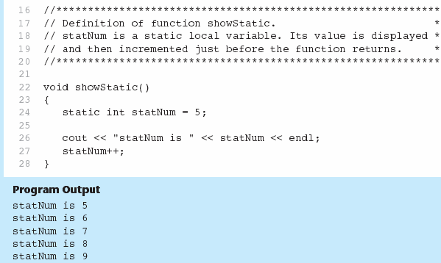
If you initialize a local static variable, the initialization only happens once.
The lifetime of a static variable is from the moment it is invoked till the end of the program.
PAGE 5

Slide 6
Default Arguments
A Default argument is an argument that is passed automatically to a parameter if the argument is missing on the function call.
Must be a constant declared in prototype:
void evenOrOdd(int = 0);
Can be declared in header if no prototype
Multi-parameter functions may have default arguments for some or all of them:
int getSum(int, int=0, int=0);
PAGE 6

Slide 7
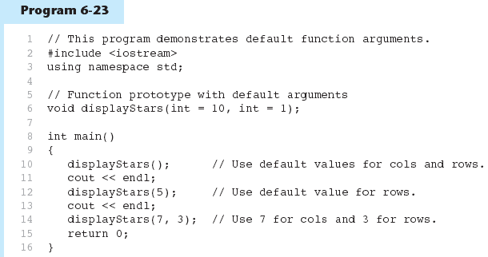
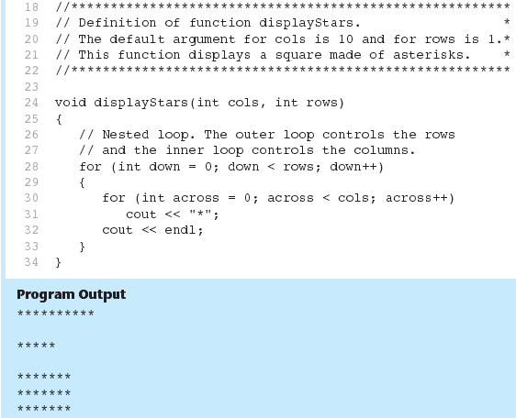
Example 3: Default Arguments
Default arguments specified in the prototype
PAGE 7

Slide 8
Default Arguments
If not all parameters to a function have default values, the default less ones are declared first in the parameter list:
int getSum(int, int=0, int=0);// OK
int getSum(int, int=0, int); // NO
When an argument is omitted from a function call, all arguments after it must also be omitted:
sum = getSum(num1, num2); // OK
sum = getSum(num1, , num3); // NO
PAGE 8

Slide 9
More info
[1] cplusplus.com: Variables. Data Types.
https://www.cplusplus.com/doc/oldtutorial/variables/
[2] learncpp.com: 6.10 – Static local variables
https://www.learncpp.com/cpp-tutorial/static-local- variables/
[3] learncpp.com: 7.7 – Default arguments
https://www.learncpp.com/cpp-tutorial/77-default- arguments/
PAGE 9

